Slide 1
Join the
CELEBRATION!
CHILDRENS AUTISM HUB
NEW OFFER!

Slide 2
Our Offer
Information, advice & signposting
Primary Age Family Fun sessions
RISE Peer Support Sessions
for parents/carers
DUGOUT Youth Group for 11 - 18 year olds
1-2-1 Advice sessions with our
Autism Specialist Advisor
All Ages Quiet Chess Club
Training Workshops
All Ages Girls Social Group
Autism Champion Training
Elevate Youth Group

Slide 3
Meet The Team
Julie
Manager
Sam
Autism
Specialist Advisor
Donna
Parent Volunteer
Charlie
Team Assistant
Tracey
Team Assistant
Julie
Team Assistant
Viki
Team Assistant

Slide 4
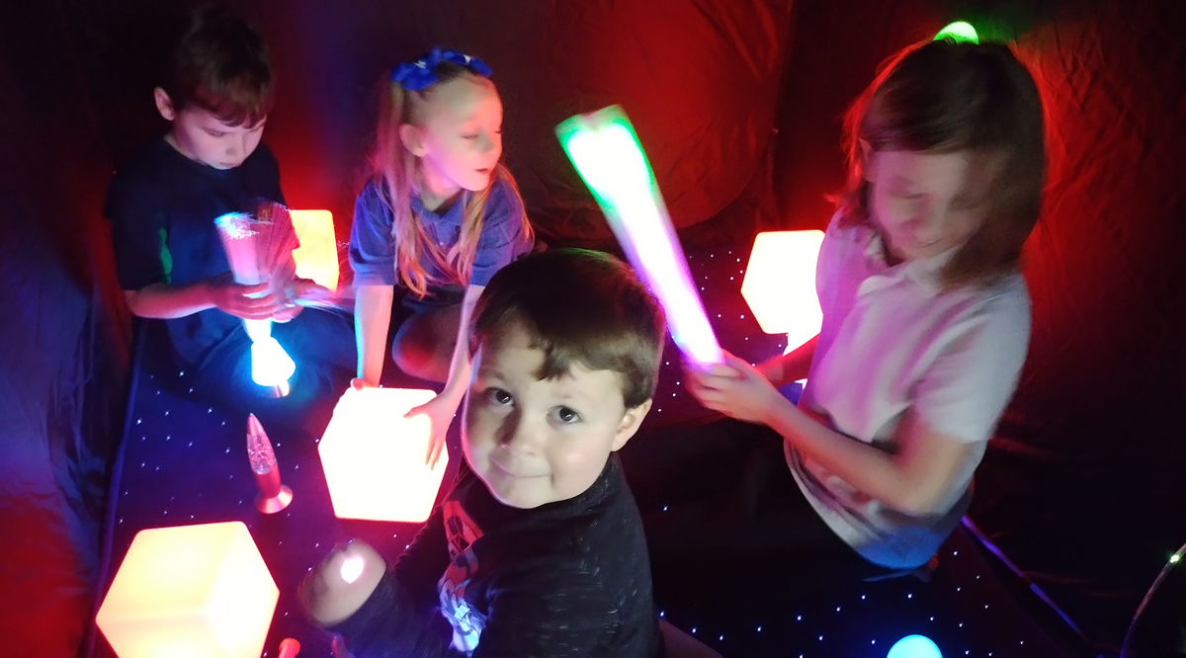
Our Hub

Slide 5
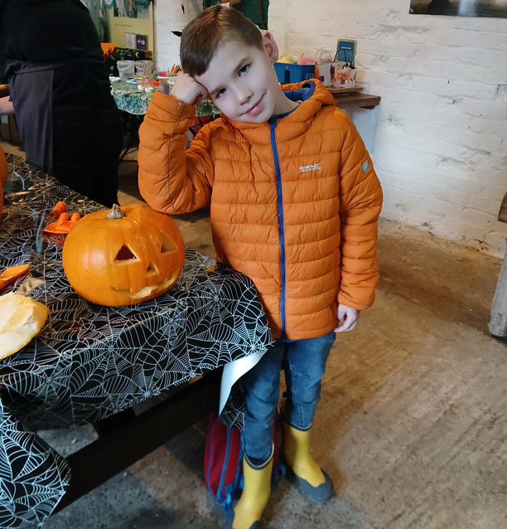
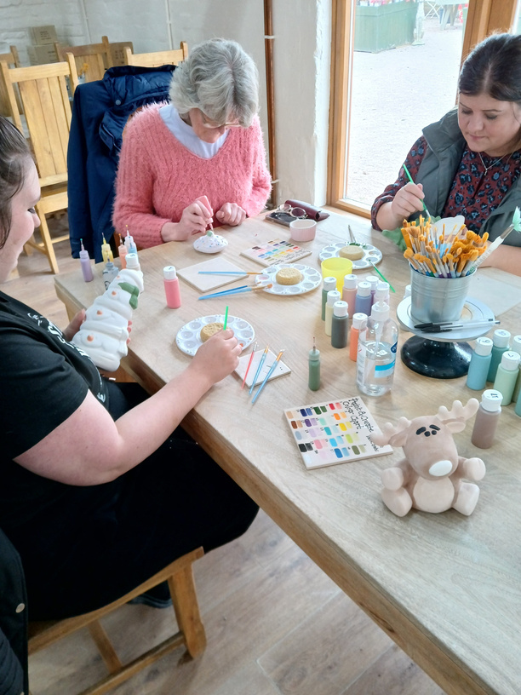
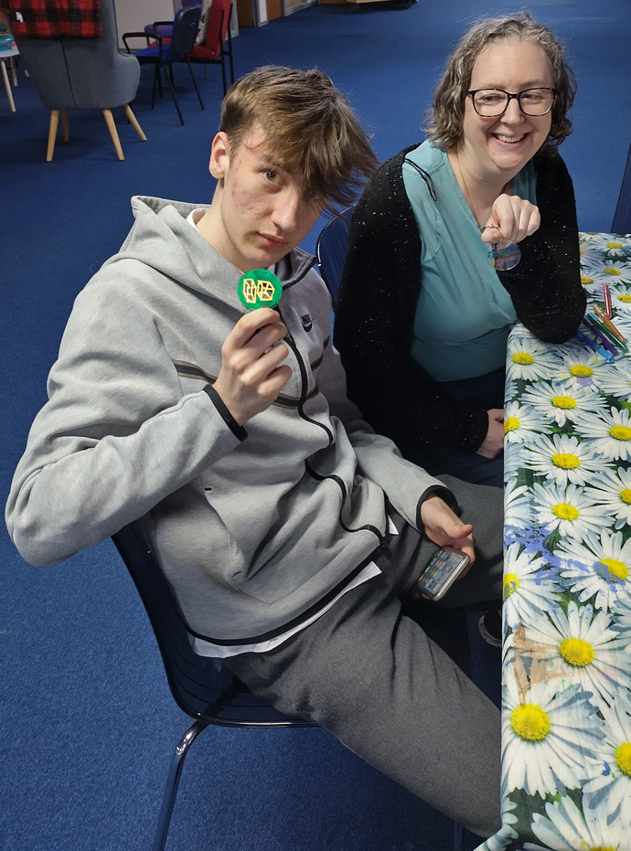
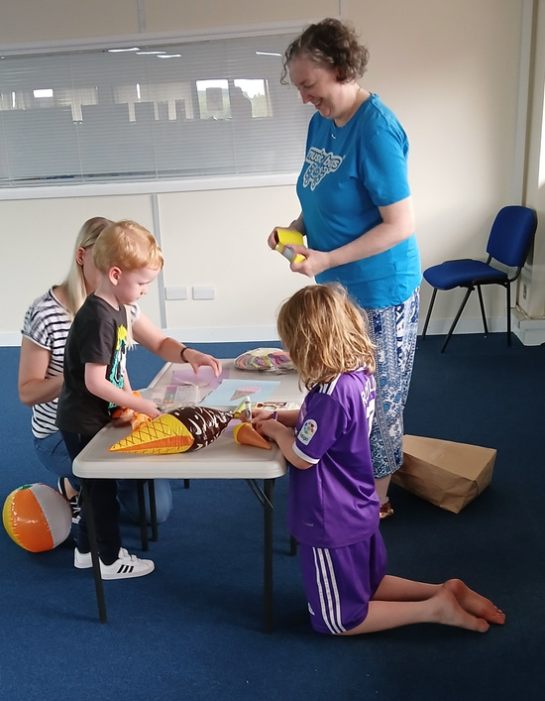
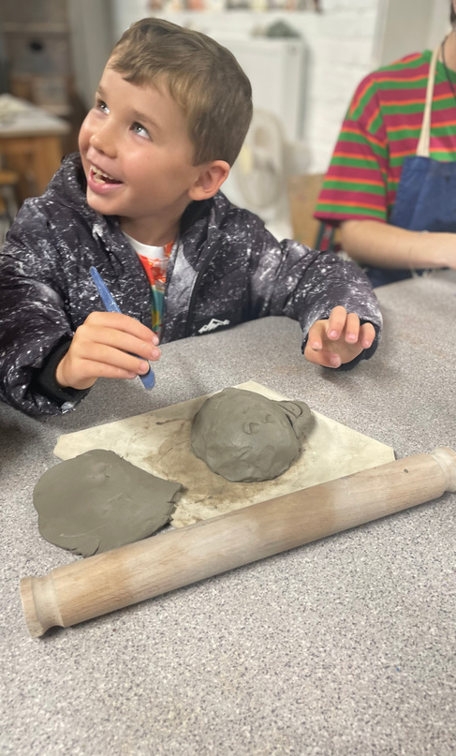
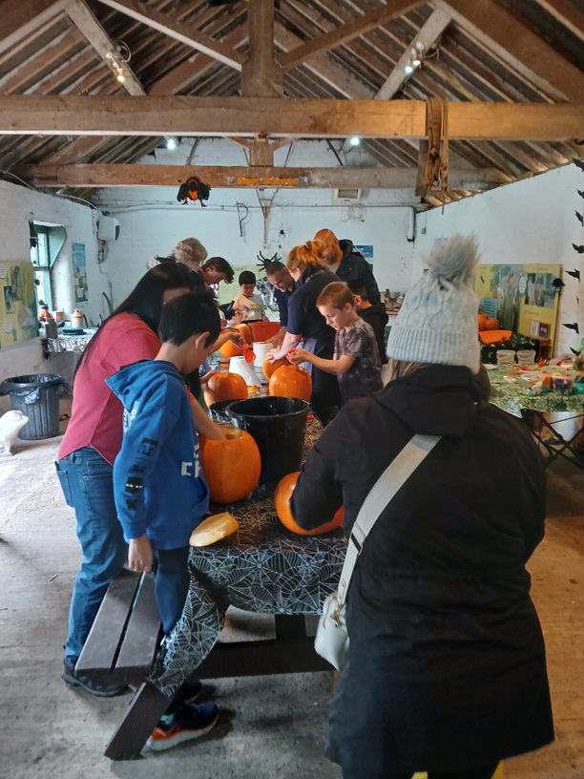
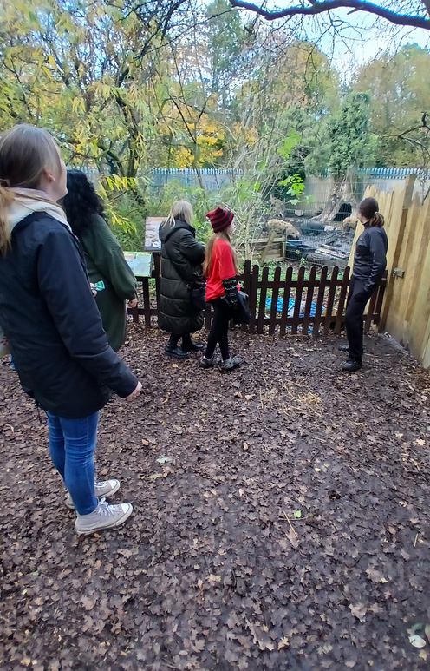
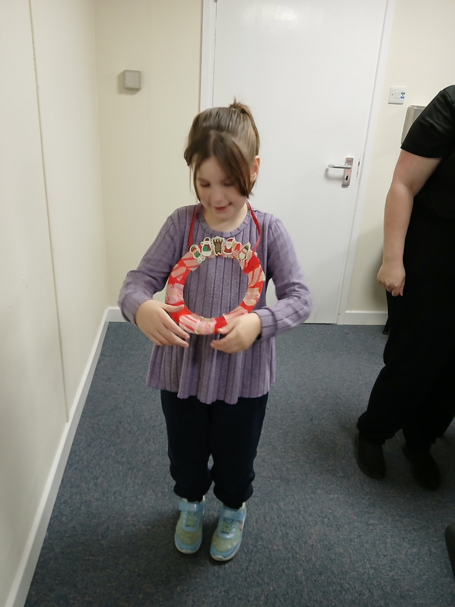

Slide 6
Words from our families
We love the TCAH and what is on offer. They have been such a fantastic support to our family.
Keep up the great work, you are making such a huge positive impact on our lives
Big thanks again to everyone involved in these sessions they are an absolute lifeline for the children and their parents .It's so amazing to see the children interact with each other and form friendships in a safe environment.
I think what you offer is so vital and needed for autistic girls. Thank you.
THE ACTIVITY SESSIONS ALLOW MY CHILD TO ENGAGE WITH CHILDREN WITH SIMILAR NEEDS, IN AN ENVIRONMENT WHERE THEY WON'T BE JUDGED ON THEIR DIFFERENCES.

Slide 7
Pre-diagnosis
Offer
Children, young people, and families can now access more support, as the Telford Children’s Autism Hub is expanding their current offer of post diagnosis support, thanks to additional funding from NHS Shropshire, Telford and Wrekin.
The extra funding means the Hub is also able to offer information, advice and support for families at the pre-diagnosis stage and who are on the pathway awaiting an Autism assessment.
Families can access the service if their child or young person is 0-18 years old and lives in Telford and Wrekin.
The Hub is funded by Telford & Wrekin Council and NHS Shropshire, Telford and Wrekin.
"We are ever thankful for any additional services to support families who are undergoing Autism assessments or wanting more information and advice. We're pleased that parent carers voices have been heard in the development of these services"
Jayne Stevens PODS

Slide 8
Participation
Elevate Youth Participation Group
Young People - Age 14-24 years
Your Voice
Make a Difference
Increase Confidence!
Improve
Learn New Skills

Slide 11
Community Support

Slide 12
Challenging Perceptions is a Telford based charity specialising in providing support for children and young people with mental health, learning disabilities, and neurodiversity needs.
Our services include:
A number of Youth well-being and peer support groups for 6 to 16-year-olds in the community and school settings
SEND parent and toddler group
Advocacy Service
Home Education Group
Sensory Room
Sensory Garden
Sensory Toy shop
Wellbeing packs for school holidays
Winter warm packs
Befriending Service
Strategic work with local authority and NHS to ensure the voices of our CYP are heard
www.cptelford.co.uk
Info@challengingperceptions.co.uk
Facebook.com/challengingperceptionstelford

Slide 33
Contact Us
We are here to help and we can also signpost you to wider services that are available to enable you to receive the right help at the right time for you.
WWW.TELFORDAUTISMHUB.ORG.UK/CHILDRENS-AUTISM-HUB
01952 262062
CHILDRENSAUTISM@TANDWCVS.ORG.UK
12 & 15 HAZLEDINE HOUSE, CENTRAL SQUARE, TELFORD CENTRE, TELFORD, TF3 4JL
TELFORD CHILDRENS AUTISM HUB

Slide 34
Funders and Supporters
SHROPSHIRE CHESS

